Slide 1
DPPHA 30560
Data Visualization
Instructor: Quoctrung Bui
Tuesdays, 8:00 am to 9:20 am Central Time
Notes:
Welcome to class.
I imagine that you’re here because you want to make interesting data visualizations.
Let’s begin with looking at a few charts.

Slide 2
What do charts do?

Slide 3
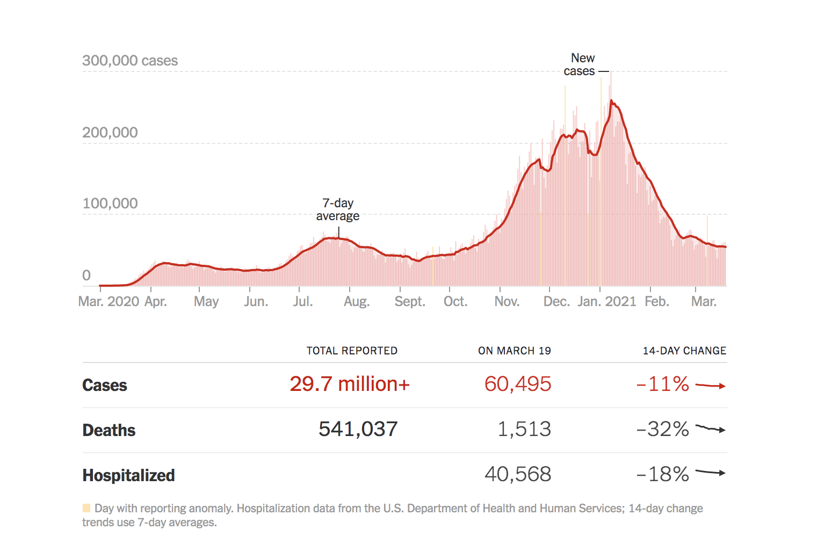
Notes:
They help us make decisions. Should I go outside today?

Slide 4
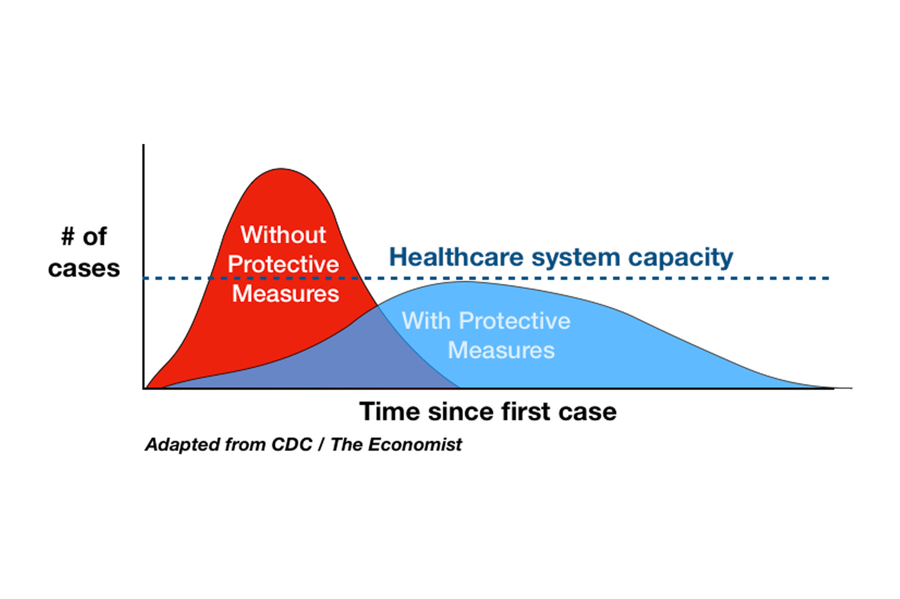
Notes:
Explain Concepts. In this case, it’s not even real data. Just a concept.

Slide 5
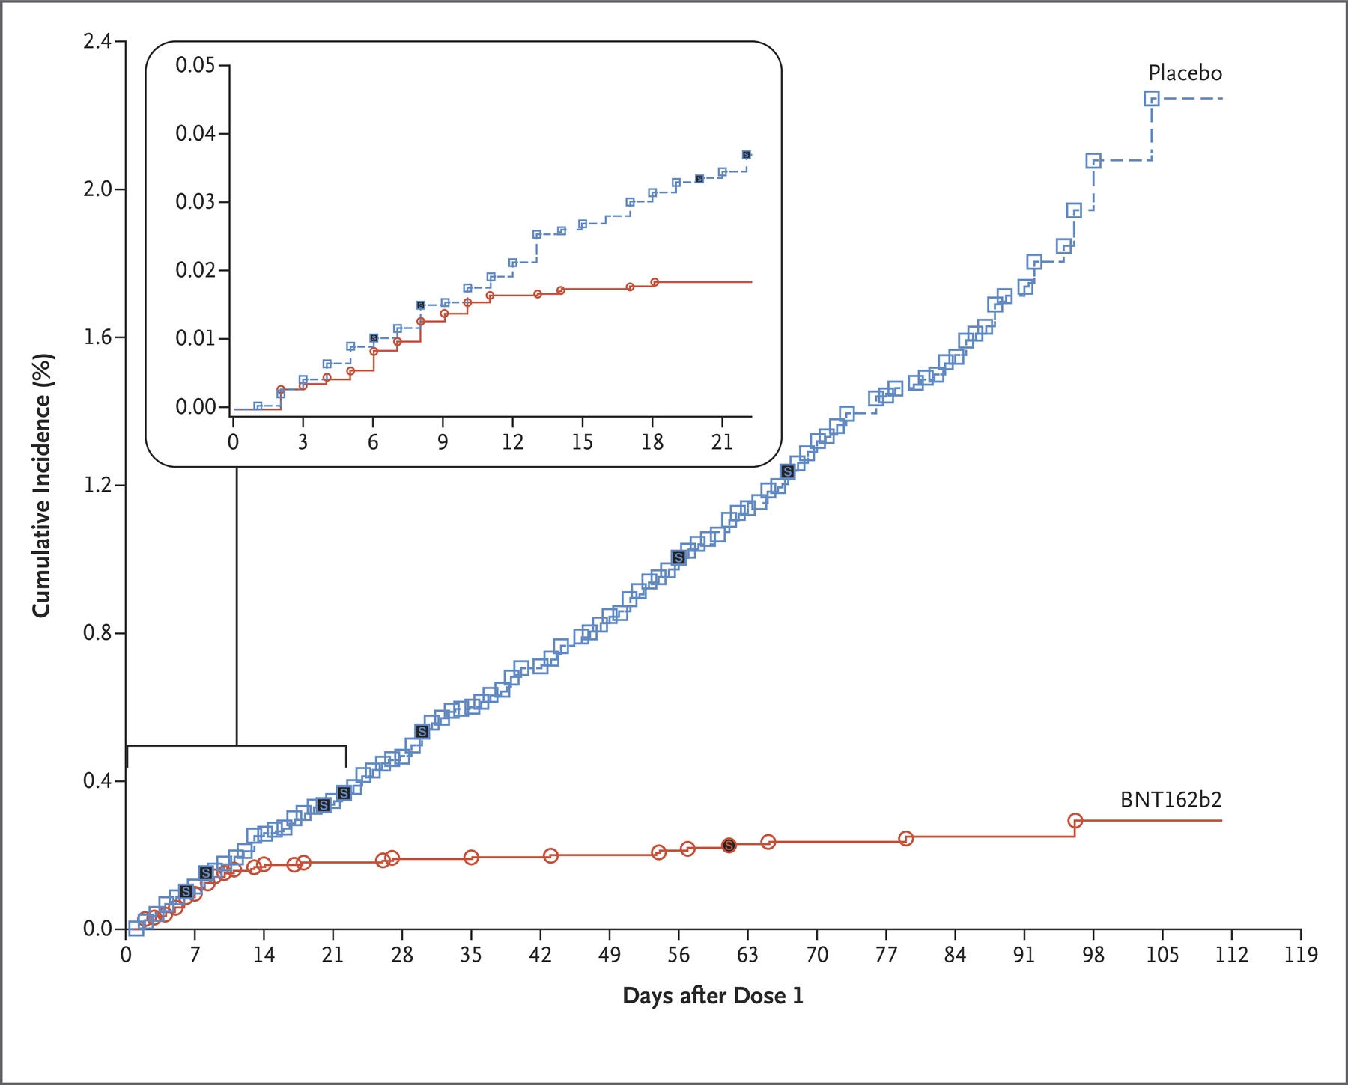
Pfizer
Notes:
Ask the class if they saw a char this chart that help them understand the work.

Slide 6
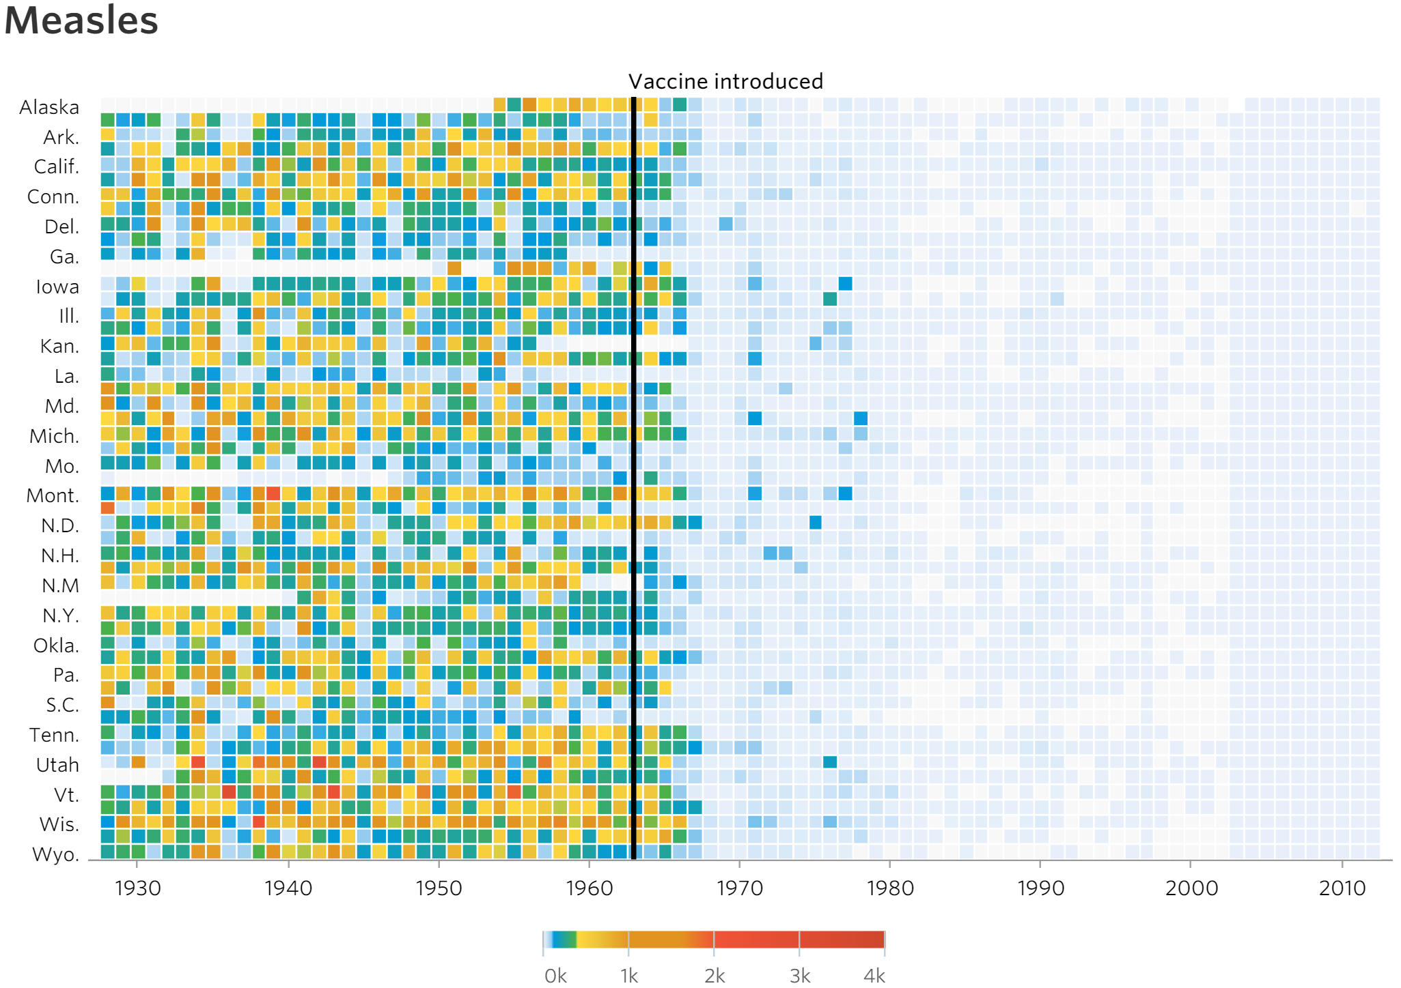
Notes:
See obvious patterns

Slide 7
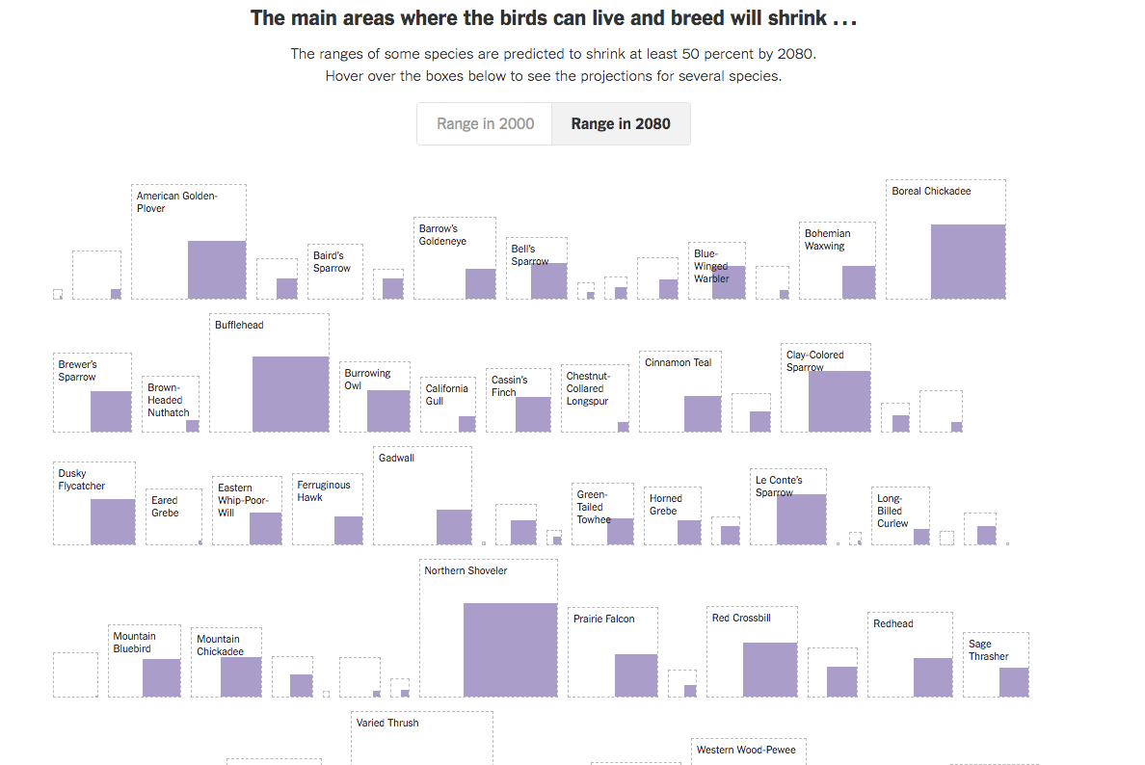
Notes:
Birds

Slide 8
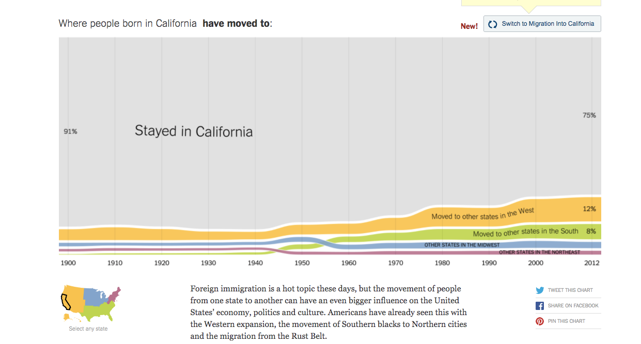
Notes:
Migration

Slide 9
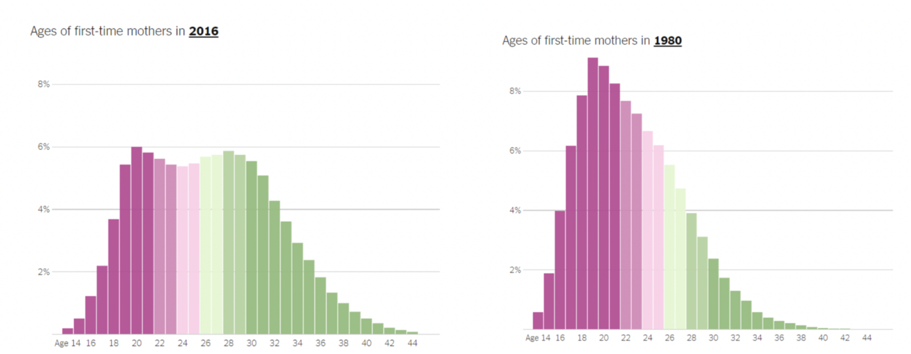
Bars
Notes:
Bars

Slide 10
What Makes A Good Chart?
A good chart is like good writing.
It’s not only about displaying data.
It’s about making a statement with data.

Slide 11
Most humans are *not* naturally numerate
Notes:
So we use our tools to reduce the mental fatigue.

Slide 12
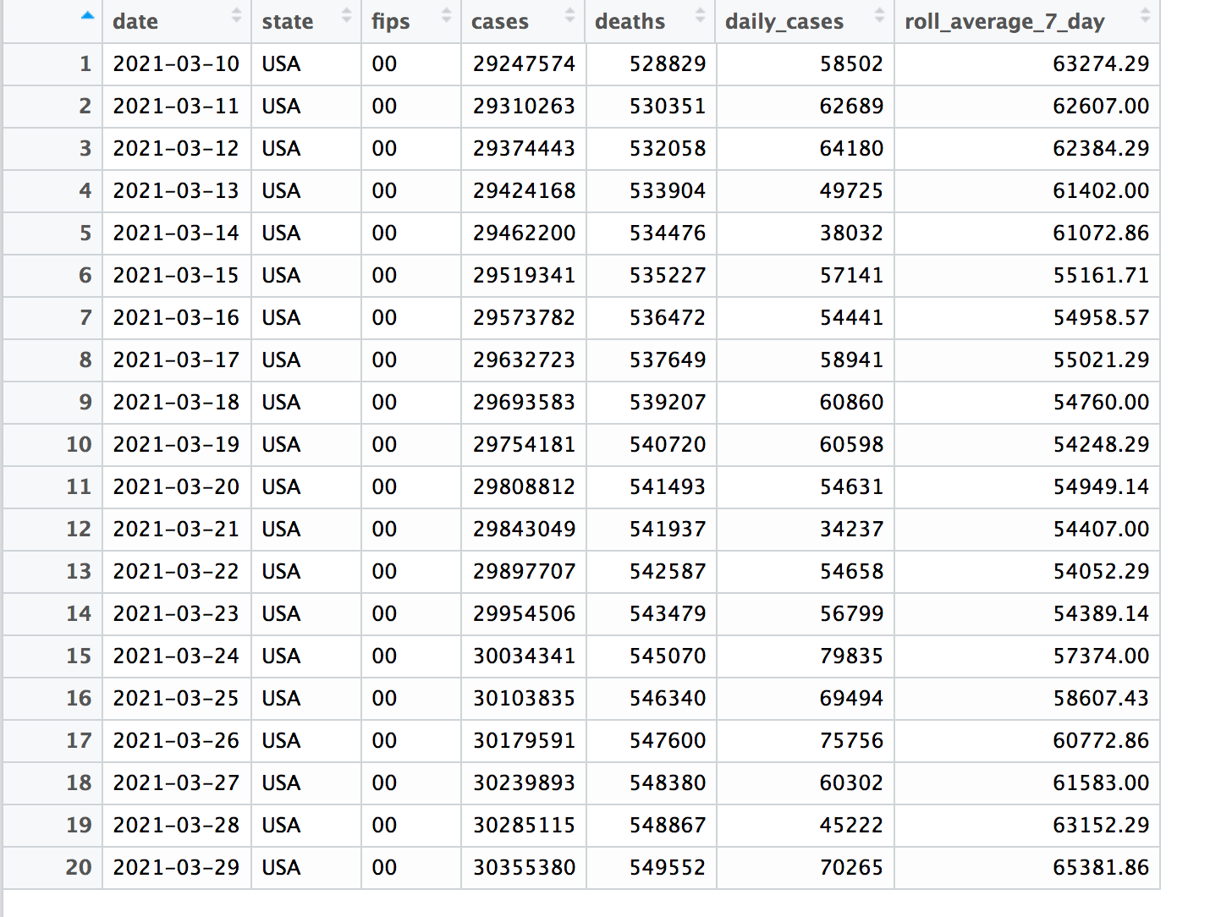
Notes:
Let’s play a game. Can someone tell me what the shape of roll_average_7_day. Can you guys draw that?
On zoom??
When is the bottom?
When is the top?

Slide 13
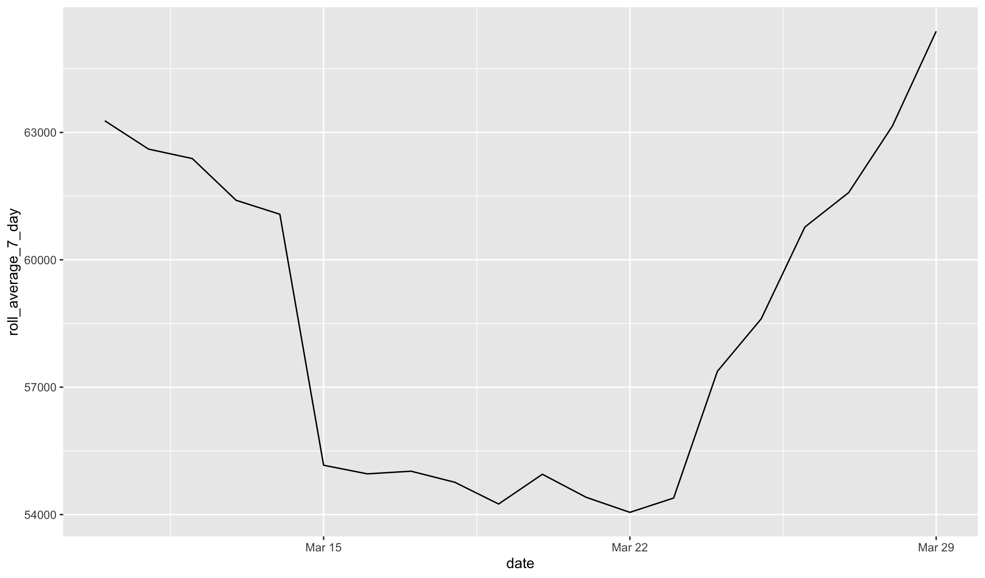

Slide 14
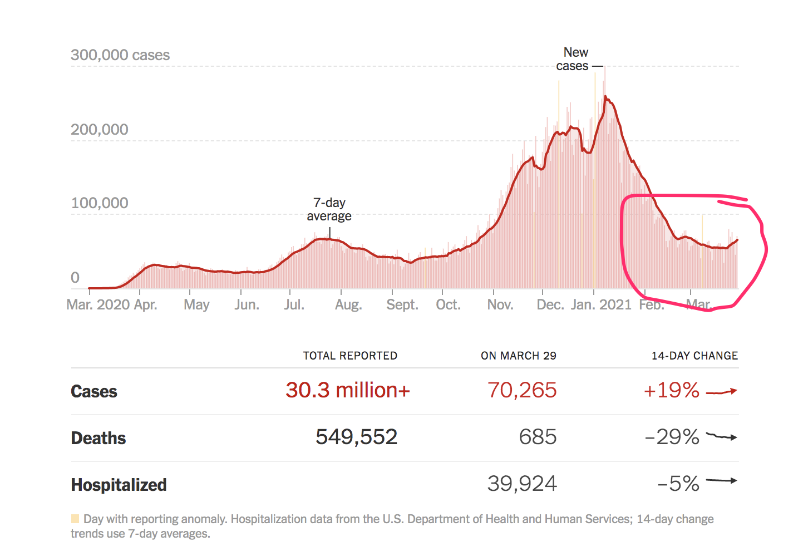
Notes:
How long did the first slide take?
How long did the 2nd slide take?
How long did the 3rd slide take? What are you getting from the 3rd slide that you’re not getting from the first slide?

Slide 15
Most humans are *not* naturally numerate
Really dumb stuff go a long way in helping us understand the world
Red = Bad
Green = Good
Bad stuff = Down
Good stuff = Up
See patterns well, harder to see gradations of color
Read variations in line well.
Read scale in lines well.
Notes:
So we use our tools to reduce the mental fatigue.

Slide 16
100% in support of beauty

Slide 17
But we’re not only looking for function
There is a trade-off between originality and clarity.
Sometimes being too literal doesn’t provoke wonder or intrigue.
AND there is practical value in originality.
People spend more time engaged on the content and remember the lessons for longer.

Slide 18
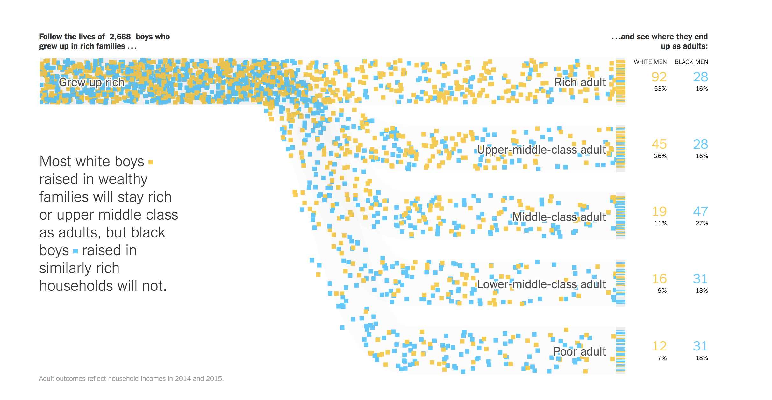

Slide 19
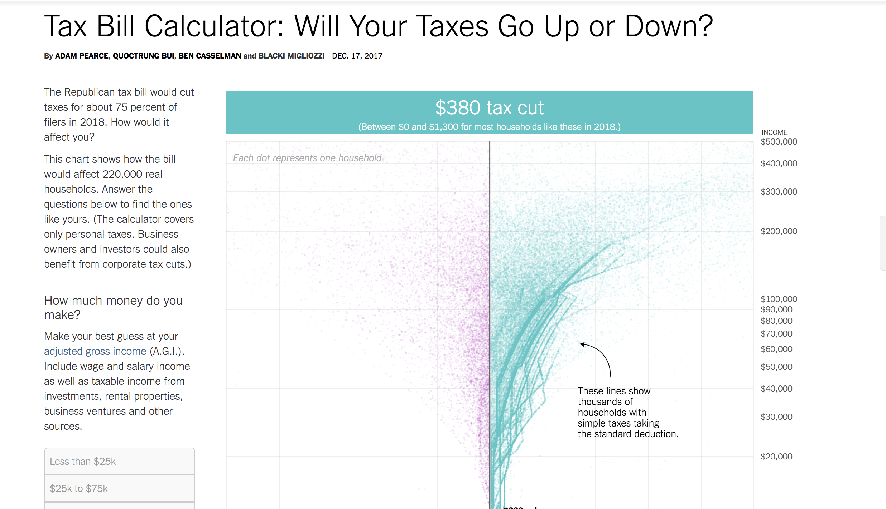

Slide 20
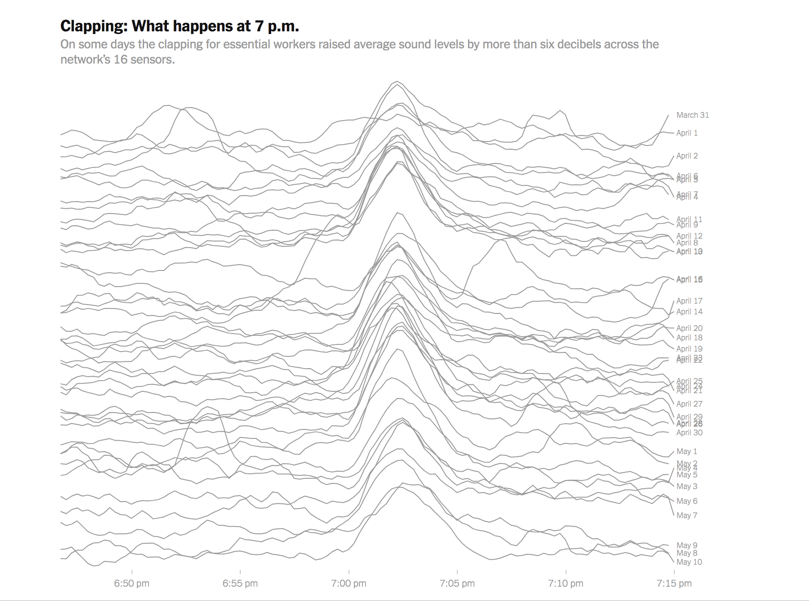

Slide 21
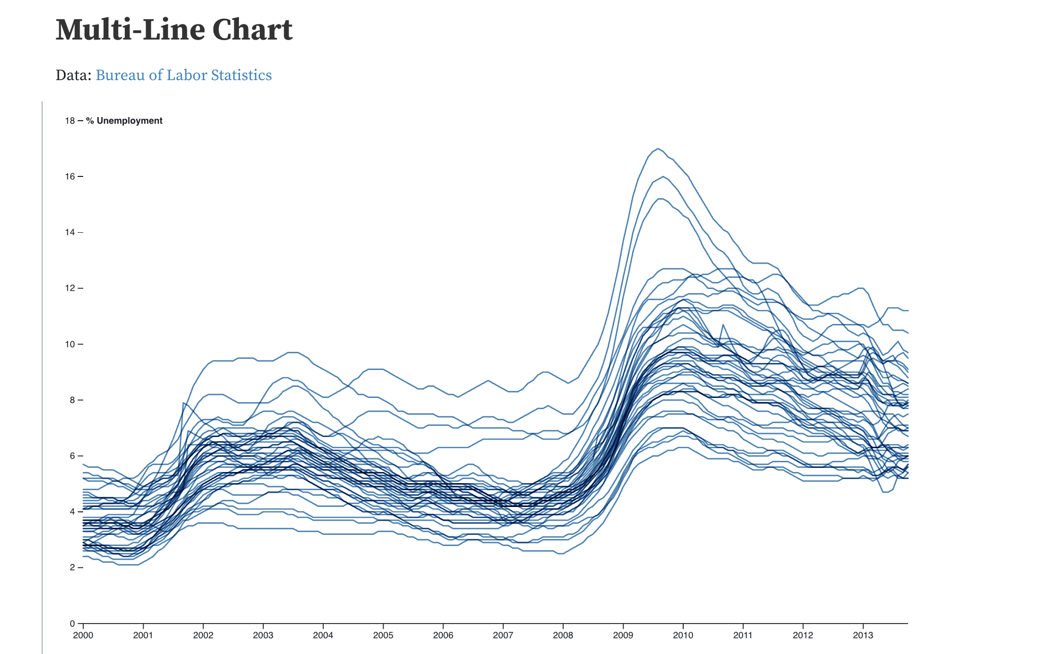
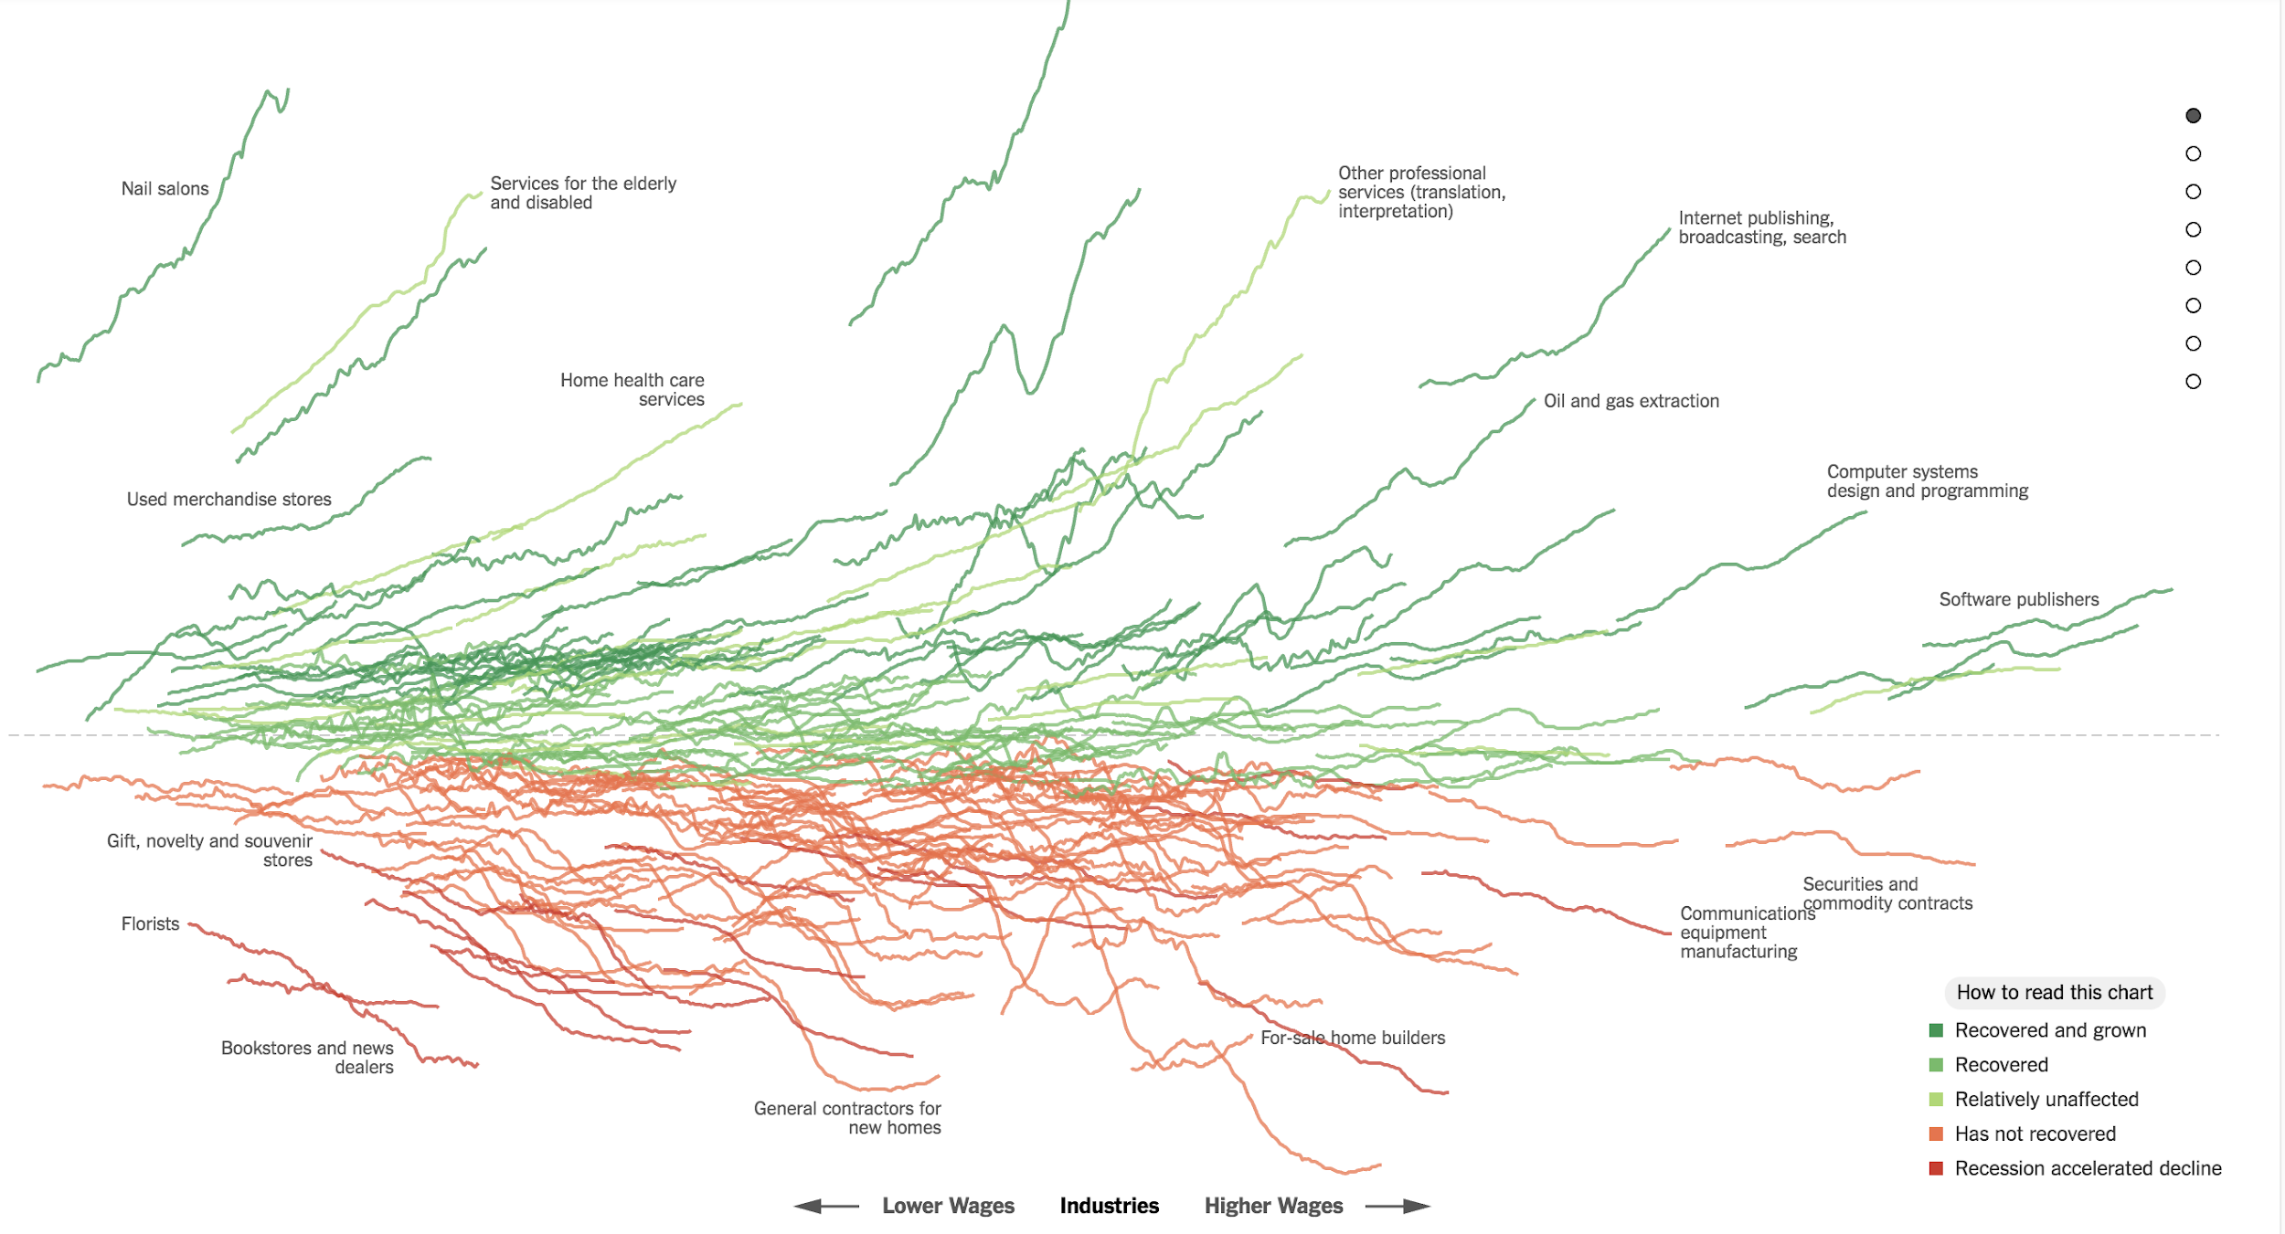
Lines
Notes:
Lines

Slide 22
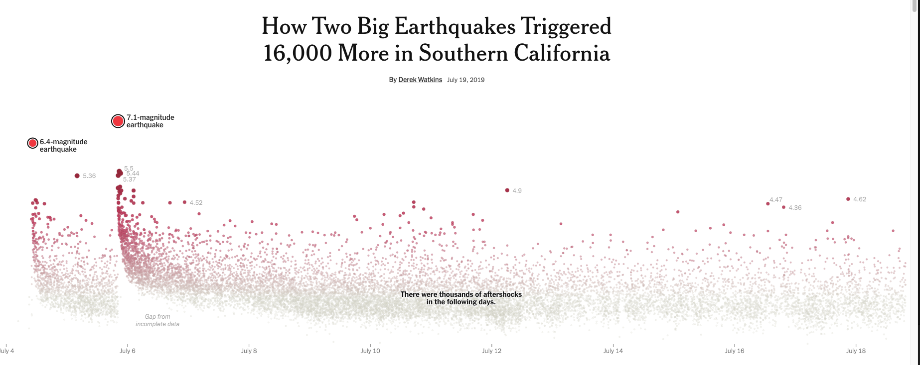
Notes:
Earthquakes

Slide 23
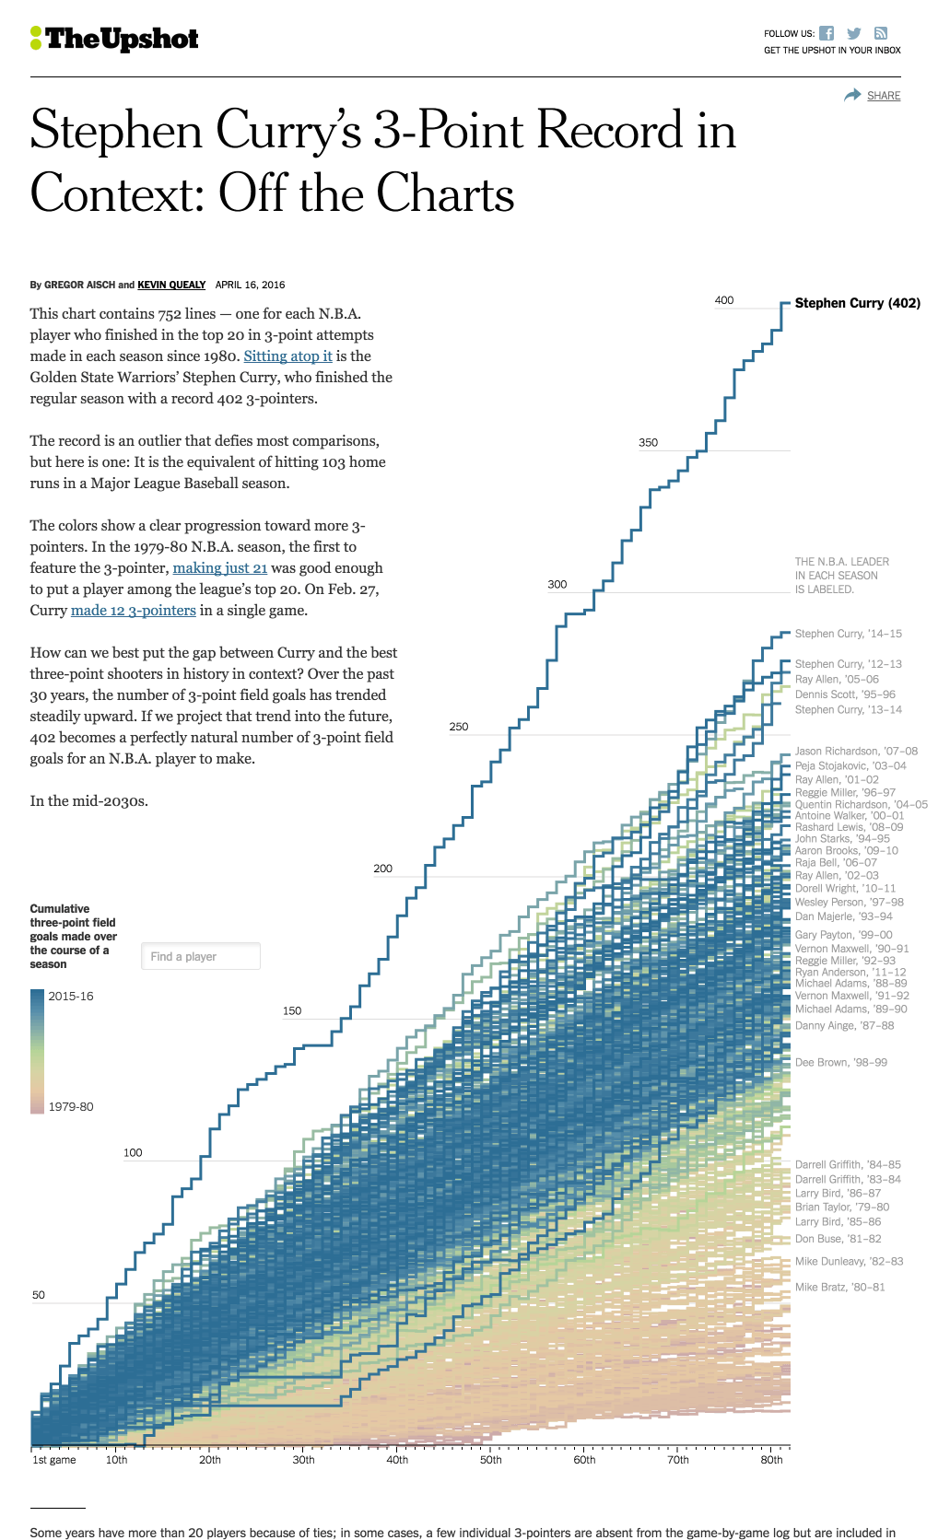
Notes:
Basketball

Slide 24
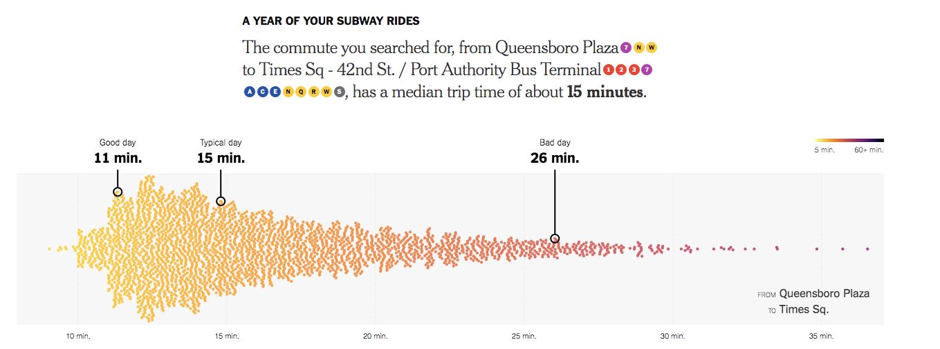

Slide 25
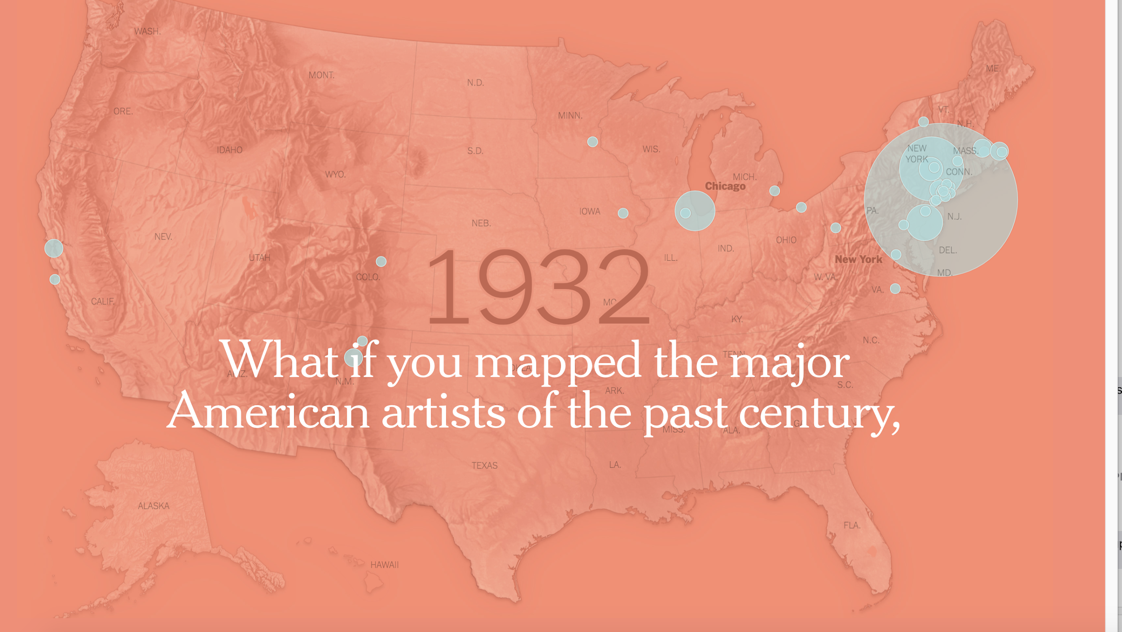
Maps with Circles
Notes:
Maps and circles

Slide 26
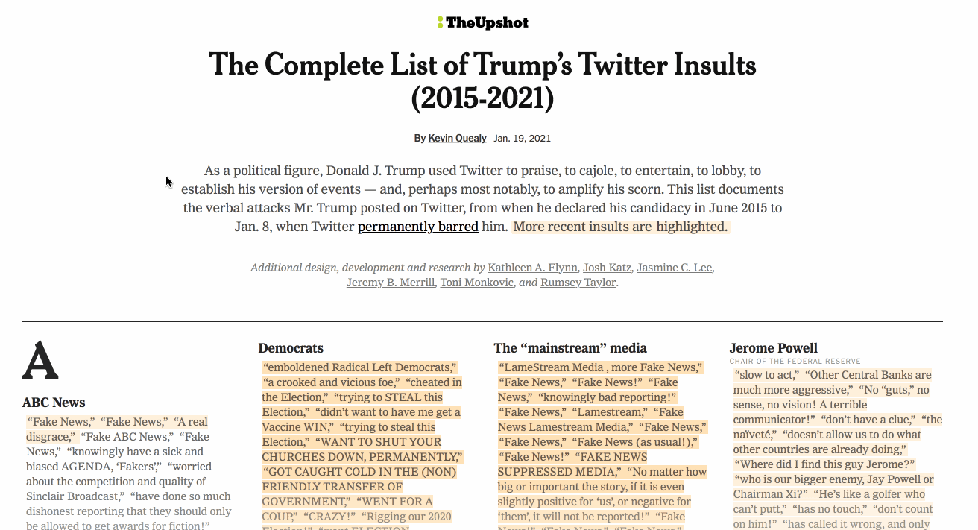
Text
Notes:
Text.
Ask class. What are other examples of forms?

Slide 27
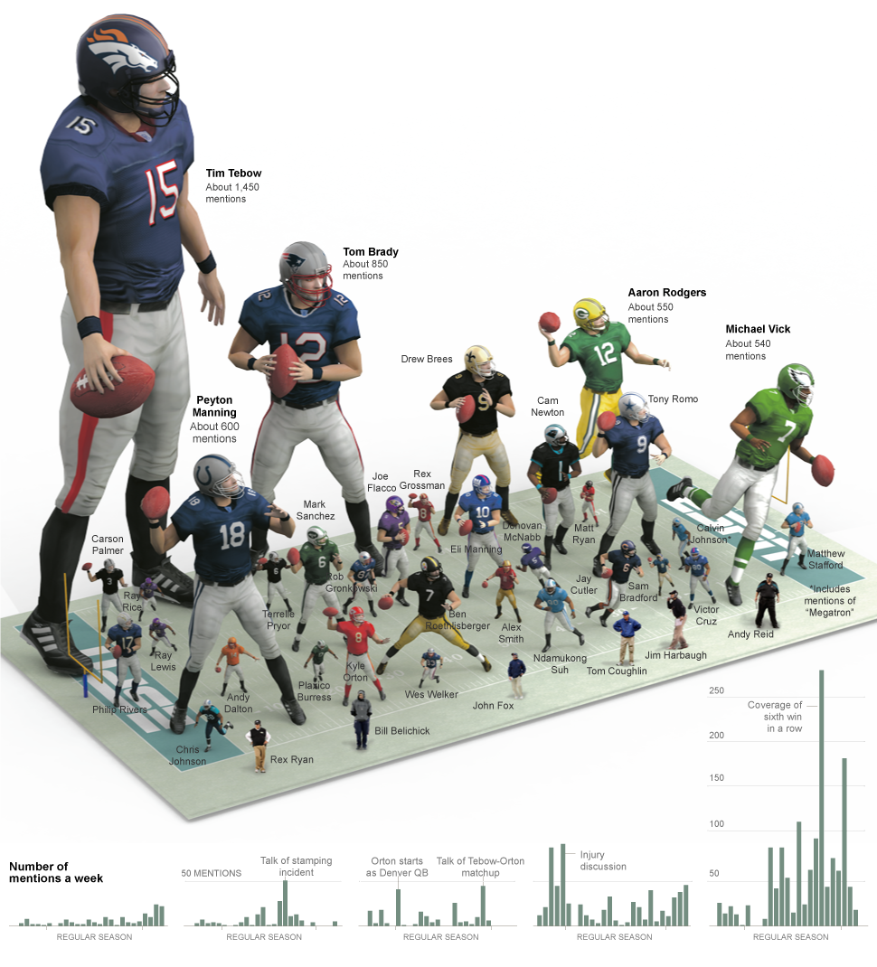
Notes:
toys

Slide 28
Data visualization is like a trade
A chart can be:
Informative
Scientific
Creative
Authoritative
Beautiful
There is not always a “right” way.
Knowing how to balance all these things is something that needs to be practiced in order to learn.
By repetition. By trial and error. By raw effort.

Slide 29
The goal
You will leave the class with a toolkit that will allow you to make these charts.
But it’s a just downpayment.
You will need to hone and refine your skills outside this class .

Slide 30
What we will cover
Workflow
Rapid sketching
Design
Form
Annotation
Making charts for the web
Interaction
Simple map making

Slide 31
Class Structure
In-class zoom lectures, 8:00 am to 9:20 am Central Time
Pre-recorded lectures, release the day after
T.A. led lab discussion, TBD
T.A. office hours,
Office hours Thursdays from 5pm to 6pm CT
With office hours, just email me to let me know if you plan on attending and when you’re coming. If no one schedules, then I won’t show.
If you have technical problem with your work please
Ask on ED first
Then escalate to your TA
Who will then ask me
More conceptual questions about design, form and structure can be sent to me directly

Slide 32
Grading
Homeworks (50%)
Some will be exercises in R
Others will be full visualizations from scratch.
Final project (50%)
Make a visualization that is “publishable”.
It can be original work, a remake of work that’s been published or that’s been completed from another class.
It can be complicated or simple but its needs to incorporate some of the tools and principles of visualization discussed in class.

Slide 33
A Workflow
Notes:
Workflows are extremely important. It guides you to make good decisions, to not be lazy, to extract the very best piece of information out of what you got. Lots of stuff needs to happen before you can even begin to get creative

Slide 34
A Workflow
Understand your data.
Definitions? Thousands? Millions? Rate? Or A Level?
Notes:
Most of your time will be spent on step 1.

Slide 35
A Workflow
Understand your data.
Definitions? Thousands? Millions? Rate? Or A Level?
How is the data being structured?
Is it wide or tidy?
Notes:
Most of your time will be spent on step 1.

Slide 36
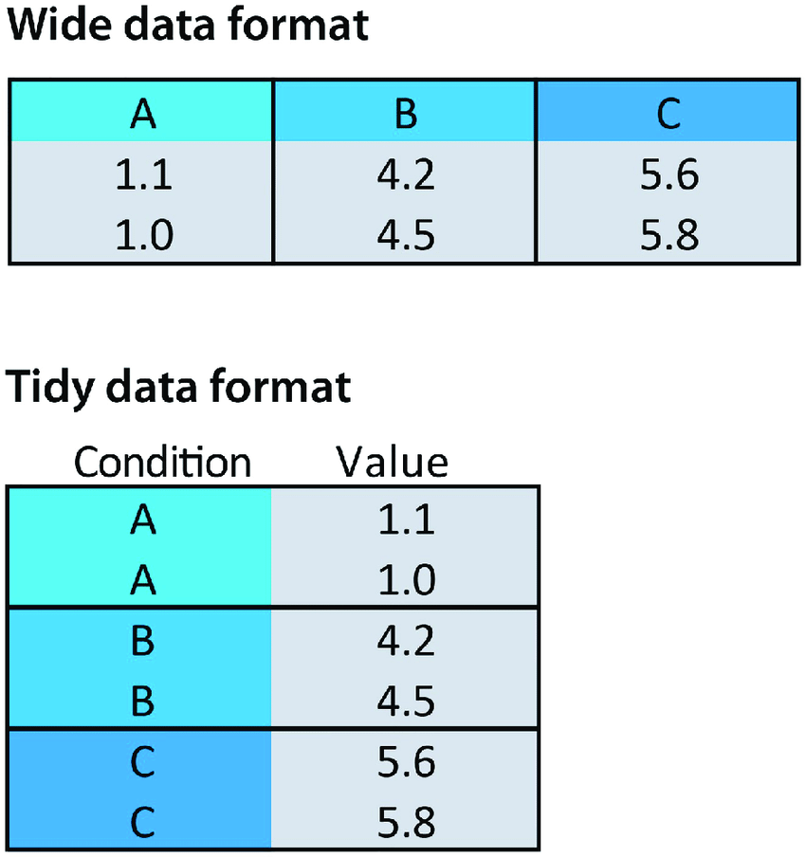
Notes:
Very important point. Wide data is easy for humans to read. Tidydata is very easy for machines to read.

Slide 37
A Workflow
Understand your data.
Definitions? Thousands? Millions? Rate? Or A Level?
How is the data being structured?
Is it wide or tidy?
Dates, numbers, strings being read correctly?
Notes:
Most of your time will be spent on step 1.

Slide 38
A Workflow
Understand your data.
Definitions? Thousands? Millions? Rate? Or A Level?
How is the data being structured?
Is it wide or tidy?
Dates, numbers, strings being read correctly?
Are there dupes?
Notes:
Most of your time will be spent on step 1.

Slide 39
A Workflow
Understand your data.
Definitions? Thousands? Millions? Rate? Or A Level?
How is the data being structured?
Is it wide or tidy?
Dates, numbers, strings being read correctly?
Are there dupes?
Is it sorted?
Notes:
Most of your time will be spent on step 1.

Slide 40
A Workflow
Understand your data.
Definitions? Thousands? Millions? Rate? Or A Level?
How is the data being structured?
Is it wide or tidy?
Dates, numbers, strings being read correctly?
Are there dupes?
Is it sorted?
What are the grouping variables?
Notes:
Most of your time will be spent on step 1.

Slide 41
A Workflow
Understand your data.
Definitions? Thousands? Millions? Rate? Or A Level?
How is the data being structured?
Is it wide or tidy?
Dates, numbers, strings being read correctly?
Are there dupes?
Is it sorted?
What are the grouping variables?
Test your understanding
Notes:
Most of your time will be spent on step 1.

Slide 42
A Workflow
Understand your data.
Definitions? Thousands? Millions? Rate? Or A Level?
How is the data being structured?
Is it wide or tidy?
Dates, numbers, strings being read correctly?
Are there dupes?
Is it sorted?
What are the grouping variables?
Test your understanding
Make basic computations
Does it add up to the expected populations? (ie is Vermont > Texas?)
Do differences in groups make sense?
Notes:
Most of your time will be spent on step 1.

Slide 43
A Workflow
Understand your data.
Definitions? Thousands? Millions? Rate? Or A Level?
How is the data being structured?
Is it wide or tidy?
Dates, numbers, strings being read correctly?
Are there dupes?
Is it sorted?
What are the grouping variables?
Test your understanding
Make basic computations
Does it add up to the expected populations? (ie is Vermont > Texas?)
Do differences in groups make sense?
Start sketching
Notes:
Most of your time will be spent on step 1.

Slide 44
A Workflow
Understand your data.
Definitions? Thousands? Millions? Rate? Or A Level?
How is the data being structured?
Is it wide or tidy?
Dates, numbers, strings being read correctly?
Are there dupes?
Is it sorted?
What are the grouping variables?
Test your understanding
Make basic computations
Does it add up to the expected populations? (ie is Vermont > Texas?)
Do differences in groups make sense?
Start sketching
It’s a check on your data cleaning.
It also gives you a feel for the data you’re working with.
Notes:
Most of your time will be spent on step 1.

Slide 45
Our tools for data analysis.
R and Rstudio.
Rstudio is the environment in which we’re going to run R on.
Our data analysis “stack”:
Tidyverse:
Dplyr (for manipulating dataframes),
Tidyr (for restructuring dataframes),
Stringr (dealing with strings),
GGplot2 (charts),
Lubridate (dealing with dates)
Purrr (fast loops),

Slide 46
Our tools for polished visualization
R + Inkscape
HTML, CSS, Javascript/D3
Mapshaper

Slide 47
Next pre-recorded lectures
Set up your R environment
I’m going to walk you through the workflow with coronavirus data

Slide 48
Homework
You’re going to repeat a simple process outlined in the pre-recorded lecture, but with a dataset I doctored that will have a bunch of errors in it.

Slide 49
Questions?

Slide 50
The end!

